Slide 1

DESIGN AND PROTOTYPING OF A FREERTOS-BASED POWER CONTROL FIRMWARE FOR HPC PROCESSORS IN GAP8
ALMA MATER STUDIORUM BOLOGNA Automation Engineering M
RELATORE | CANDIDATO
Chiar.mo Prof. Luca Benini | Giovanni Bambini
CORRELATORI
Prof. Andrea Bartolini Prof. Christian Conconi Dr. Ing. Simone Benatti

Slide 2




Contribution Project Analysis
First Power Controller
Firmware for RISC-V
Firmware on a RTOS
PROJECT
Power Controller System
Implementation on GW GAP8
Characterization of Overheads
Control up to 64 Cores
HIL Successful Testing
Notes:
we designed

Slide 3





HPC Problem Introduction
High Power Density and Computing Performance
High Energy Efficiency
Dynamic and Flexible Thermal and Power Control
Increasing amount of heterogeneous Computation Units
Notes:
The project is born to answer a current HPC problem deriving from the significantly increase request of performance, in a decade..
must operate not only … because of limited power budget and thermal constraint on the computing units

Slide 4


Power Controller System Requirements Introduction
Power Controller System
(PCS)
Meet different Real-Time and Performance constraints
Accurate and Optimized Thermal control and Power Capping
Capability to communicate with multiple agents and modify the control policy accordingly at run-time
Capability to deploy advanced control policy for higher amount of heterogeneous computing unit
Flexibility, Modularity, Upgradability, Maintainability, Scalability and Portability of the Firmware
Notes:
This situation requires an advanced design of the power …
… which is an embedded control unit integrated in the processor that handles the control of the operating point of each core

Slide 5


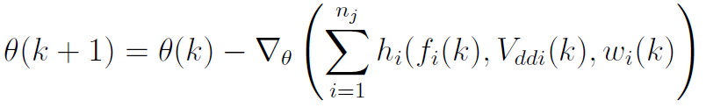
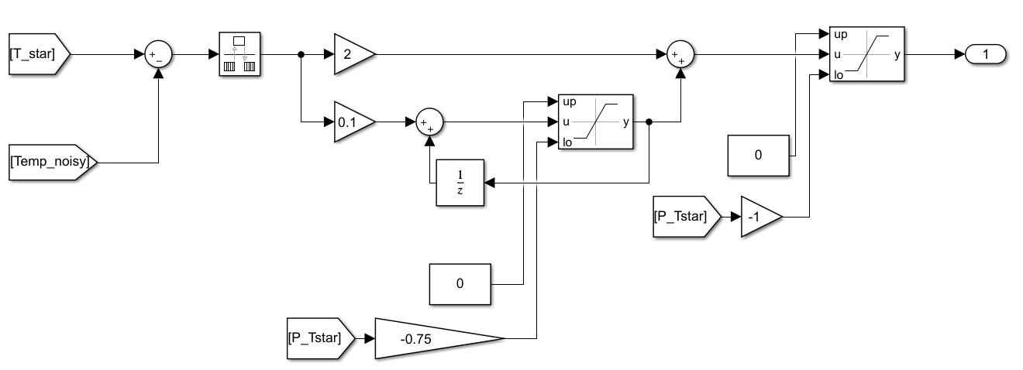
Control Solution The structure
POWER DISPATCHING LAYER
MODEL ADAPTATION
In charge of distributing the requested power among cores, according to power limitations and other constraints.
Online Model identification to improve the power model, improving the control performance. It can run with a slower period interval.
THERMAL CONTROL
PIDs that allocate core frequencies in order to meet temperature constraints for each Core. Period < 1ms to cope with thermal dissipation time constant.
_{Target Frequencies}
_{Estimated Workloads}
_{Total Power Budget}
Power Consumption Sensors
Power Dispatching Layer
_{Power Model Parameters}
Temperature
Sensors
P_{T} [P₁, …, P_{n}]
Model Adaptation
Thermal Control
_{Applied Input (Power)}
F [F₁, …, F_{n}]
V_{dd} [V_{dd1}, …, V_{ddn}]
_{CONTROLLER}
Notes:
The control structure we implemented..
The inner thermal control is carried on by a closed loop PI (one for each core) that limits the temperature of the core to a maximum value

Slide 6



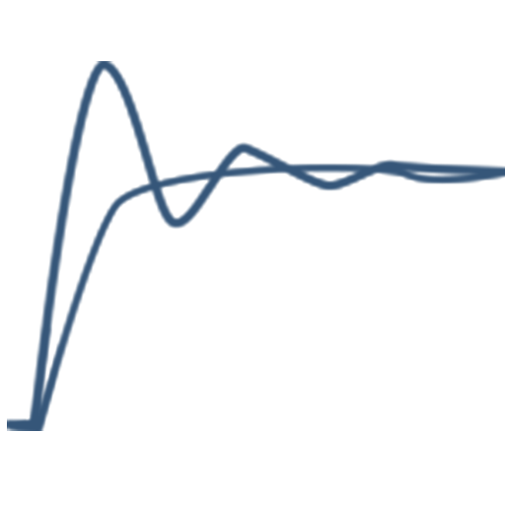
Addressing the Problem The Choices
RISC-V Microcontroller
RTOS
We chose a RISC-V based microcontroller as the hardware that implements the Power Controller.
We chose to Develop the Power Controller firmware over a Real-Time.
HPC Problem
MultiCore Power Controller
Advanced Control Policies
We chose to adopt a PULPissimo architecture design. The uC can include an 8 parallel cores cluster and other accelerators.
Control policies able to meet multiple heterogeneous requirements.
Notes:
Parallel ultra low power
The multicore design of the PCS allows to implement and support more advanced and computationally complex control policies, for larger number of cores, while the efficiency of the PULP-based chip keeps the power consumption low
To address the flexibility, modularity and to meet the mixed..

Slide 7




Design Choices Firmware Implementation
FREERTOS and TASKS
FreeRTOS is chosen as the RTOS due to its characteristics. We coded 3 tasks to implement the Control Structure and the I/O required.
NOTIFICATION SYSTEM
The FreeRTOS Notification System was used to set the periodicity of the Tasks.
500us PERIOD
The Periodic Interval for the execution of the control is 500us. The frequency is higher than other solution in the market to achieve better performance.
SHARED MEMORY ACCESS
The Tasks exchange data through shared memory variables that are accessed through Mutexes with Priority Inheritance mechanism.
TIMER ISR
The Periodic Interval is set with TIMER Interrupts. Thus we are decoupled from the FreeRTOS structure increasing flexibility and Reliability.
Notes:
Race conditions and locks

Slide 8
TASKS IMPLEMENTATION
Control Task:
PM Adaptation Task
Thermal Control
Power Capping
Telemetry Collecting
500us Periodicity
Highest Priority to meet hard real-time deadline
Power Model Adaptation
Collects inputs from multiple agents
Sends command to the Periodic Control Task
Send Telemetry and Error Data
Periodicity = k · 500us (k = 2)
Medium Priority
Telemetry Task
Timer ISR
Timer ISR
Timer ISR
Board Management Control
Manage BMC-related operations
It is event-triggered
Lower Priority
BMC Request
Control Task
PM Adapt. Task
Telemetry Task
Idle Task
0
500 us
1000 ms

Slide 9
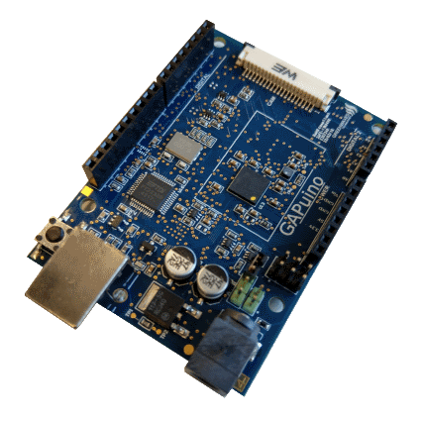
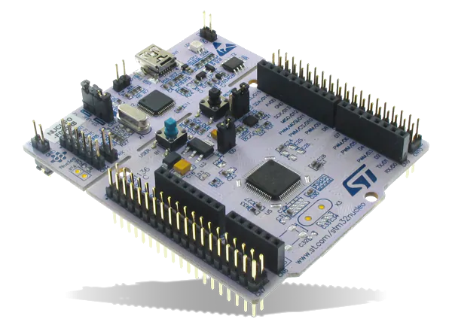
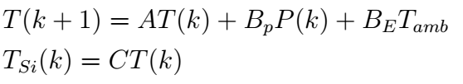
Setting Up the Hardware
in the Loop (HiL) Test
Power Control Firmware Implementation:
Plant Simultation – 1 Quadrant EPI
SoC: GreenWaves GAP8v1 @ 50MHz
Simulated Time 100ms = 500us
Floating Point Operations Emulation (FPU missing)
SPI master @ 1MHz
SoC: STM32 Nucleo F401RE
Discrete Thermal Model State Space Simulation
Continuous Computation
SPI slave managed through ISR and DMA
UART communication to collect Simulation Data
SPI Communication
Notes:
To test our design of the power controller, we arranged an hardware in the loop test implementing ..
.. and the simulation of the chip on ..
.. The plant model has been obtained by discretizing..

Slide 10
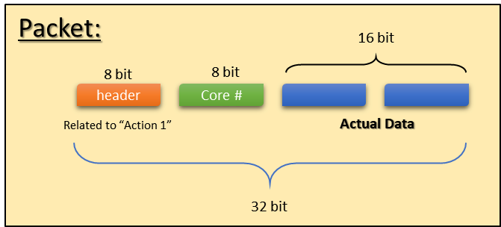
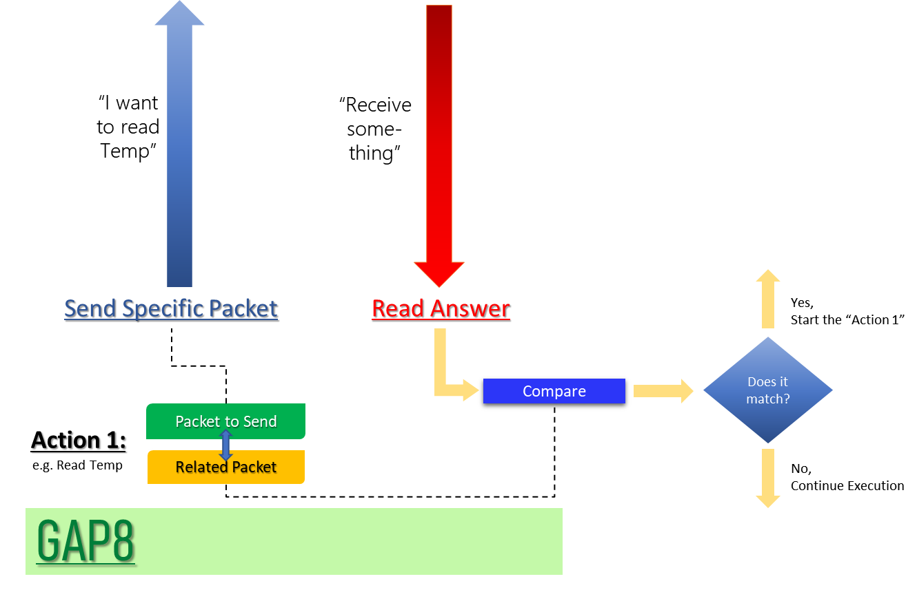
SPI HANDSHAKE SYSTEM
To Achieve:
Robust SPI Communication
Communication Flexibility
Continuous model computation of the SPI slave
Modularity
Notes:
Since the Communication is managed ascynchronously on the Nucleo (without any sequence) we designed an handshake and a packet control system for the spi to improve…

Slide 11
FREERTOS TEST: Feasibility
 | Activation Time (in Cycles) | Context Switch (in Cycles)
Mean | 1810 | 1453
Standard Deviation | 8,78 | 13,16
Range (Max – Min) | 34 | 55

Slide 12
FREERTOS TEST: Feasibility
 | Activation Time (in Cycles) | Context Switch (in Cycles)
Mean | 1810 | 1453
Standard Deviation | 8,78 | 13,16
Range (Max – Min) | 34 | 55
Activation Time
It is the time needed to unblock and run a Periodic Task through the TIMER ISR and the Notification System.

Slide 13
FREERTOS TEST: Feasibility
 | Activation Time (in Cycles) | Context Switch (in Cycles)
Mean | 1810 | 1453
Standard Deviation | 8,78 | 13,16
Range (Max – Min) | 34 | 55
Activation Time
It is the time needed to unblock and run a Periodic Task through the TIMER ISR and the Notification System.
Context Switch Time
It is the time needed to block a task through the Notification system API call, perform a context switch and start running a task.

Slide 14
FREERTOS TEST: Feasibility
 | Activation Time (in Cycles) | Context Switch (in Cycles)
Mean | 1810 | 1453
Standard Deviation | 8,78 | 13,16
Range (Max – Min) | 34 | 55
Activation Time
It is the time needed to unblock and run a Periodic Task through the TIMER ISR and the Notification System.
Context Switch Time
It is the time needed to block a task through the Notification system API call, perform a context switch and start running a task.
Analisys:
The jitter is negligible
Total Time
25000 Cycles
At 50 MHz in a 500us periodic interval we have 25.000 cycles.
Notes:
if we consider a common task exeution scheduling

Slide 15
FREERTOS TEST: Feasibility
 | Activation Time (in Cycles) | Context Switch (in Cycles)
Mean | 1810 | 1453
Standard Deviation | 8,78 | 13,16
Range (Max – Min) | 34 | 55
Activation Time
It is the time needed to unblock and run a Periodic Task through the TIMER ISR and the Notification System.
7,2%
Context Switch Time
It is the time needed to block a task through the Notification system API call, perform a context switch and start running a task.
5,8%
Analisys:
The jitter is negligible
The overheads are not negligible
Total Time
25000 Cycles
At 50 MHz in a 500us periodic interval we have 25.000 cycles. FreeRTOS overheads are about 20% of the total amount of cycles.
-20%

Slide 16
FREERTOS TEST: Feasibility
 | Activation Time (in Cycles) | Context Switch (in Cycles)
Mean | 1810 | 1453
Standard Deviation | 8,78 | 13,16
Range (Max – Min) | 34 | 55
Activation Time
It is the time needed to unblock and run a Periodic Task through the TIMER ISR and the Notification System.
7,2%
Context Switch Time
It is the time needed to block a task through the Notification system API call, perform a context switch and start running a task.
5,8%
Analisys:
The jitter is negligible
The overheads are not negligible
Analyzing the Load stalls and Instructions miss, about 37% of the cycles overhead can be optimized by hardware modifications
If the uC runs at 250MHz the overheads reduces to the 4% of the total cycles
Total Time
25000 Cycles
At 50 MHz in a 500us periodic interval we have 25.000 cycles. FreeRTOS overheads are about 20% of the total amount of cycles.
-20%

Slide 17
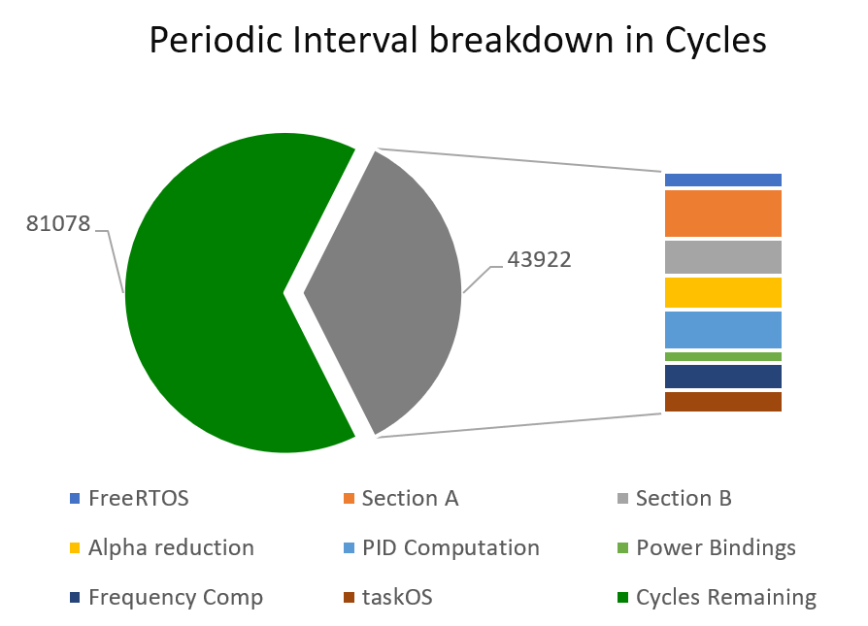
TEST: Control Execution Timings Verification
Cycles used at 250MHz
35%
Section A
Section B
Alpha Reduction
PIDs Computation
Power Bindings
Frequency Computation
TaskOS Execution
9153
6696
6156
7498
2324
4806
4310
Notes:
Test a 36 core

Slide 18
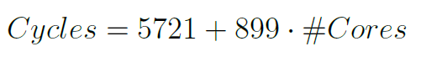
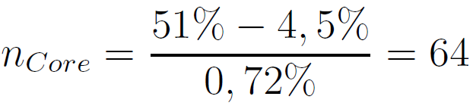
Scalability Linearity and Max Cores Projection
Scalability Equation
of the Periodic Control Task
Analysis
The amount of Fixed Cycles is high (4,5% of the amount of Cycles in the Periodic Interval). The amount of Cycles per Core is good (0,7% of the total).
Projected Maximum number of Cores
Considering to occupy only just 51% of the available cycles per periodic iteration

Slide 19
CODE PERFORMANCE IMPROVEMENT
Fixed Cycles value is too high
Caused by multiple accesses to the Shared Memory variables: Mutex add overheads. New Design access Shared variables only once (at start or in the end) storing the data into a Local Variable, increasing the memory footprint of the Firmware.
Improvements
With the new design the cycles decreased in multiple sections. In the last they increased because is where memory is accessed. Now the Periodic Task executes in 31.750 cycles with 13,30% cycles improvement.

Slide 20
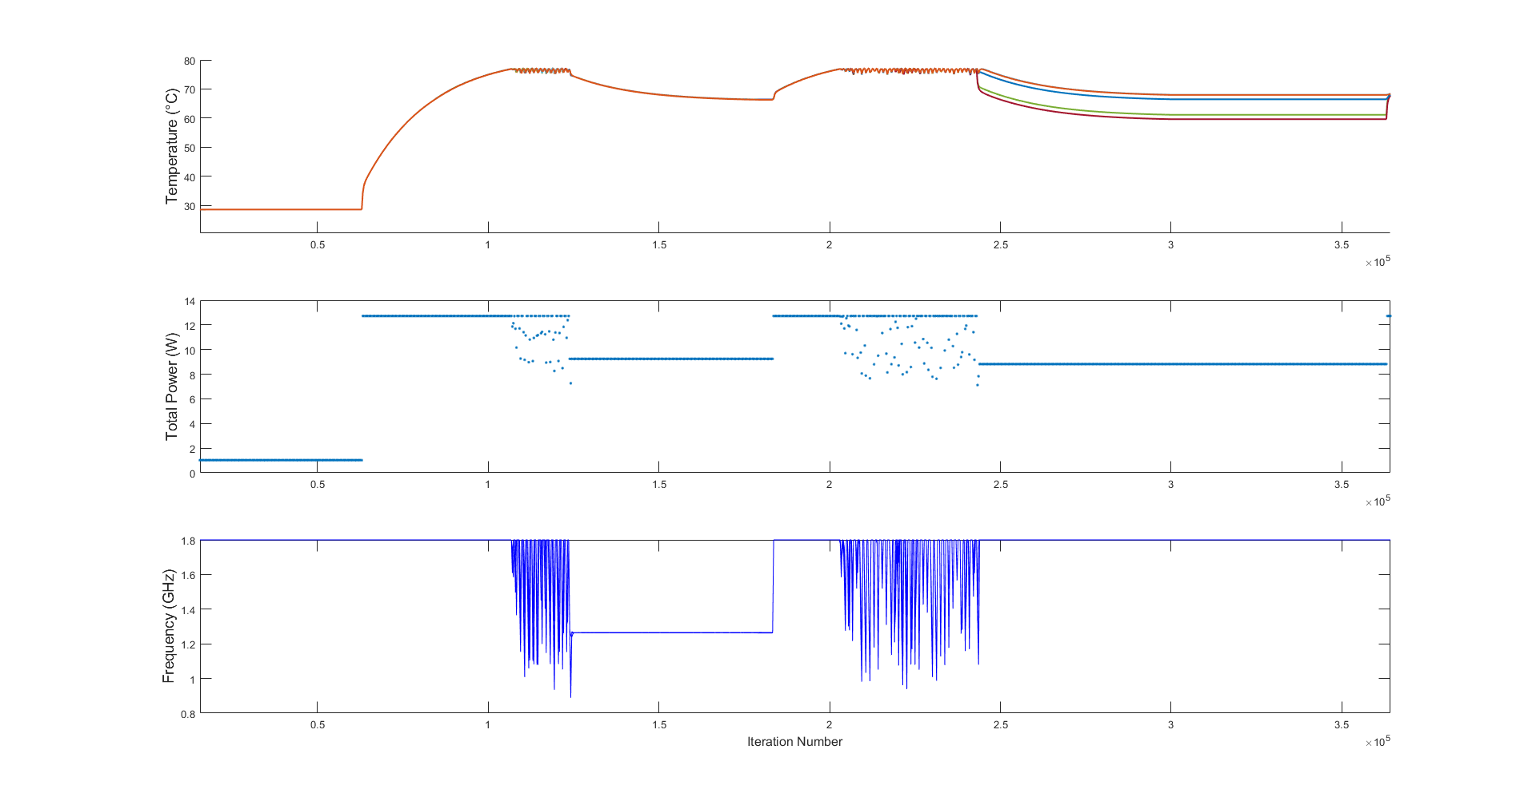
HIL RESULTS
1
2
3
4
5
HPC Workflow
Simulation:
Action 1: Low Workload
Action 2: Thermal Constraint
Action 3: Power Capping
Action 4: Thermal Constraint
Action 5: Workload Relaxation
Notes:
Lastly we executed the hardware in the loop test. We provided as input a typical HPC workflow and we plotted the acquired data on matlab

Slide 21



Future Works The EPI project
Further Improve Firmware and Control
1
Improve Code optimization. Improve Security regarding the input, output and control values. Adding new Features.
Test on FPGA with Hardware Optimization
2
An FPGA version of the PCS is being developed. Further tests could be done to optimize performance and carry on a Hardware/Software co-design.
Power Controller System
Optimal Control Implementation – Exploit Cluster Accelerator
3
Deploy and optimize for parallel computation an Optimal Control
EPI Project
4
Release the Project open-source. Include the developed PCS inside EPI project.
Notes:
The work of this thesis open the way for some future works on this project.

Slide 22
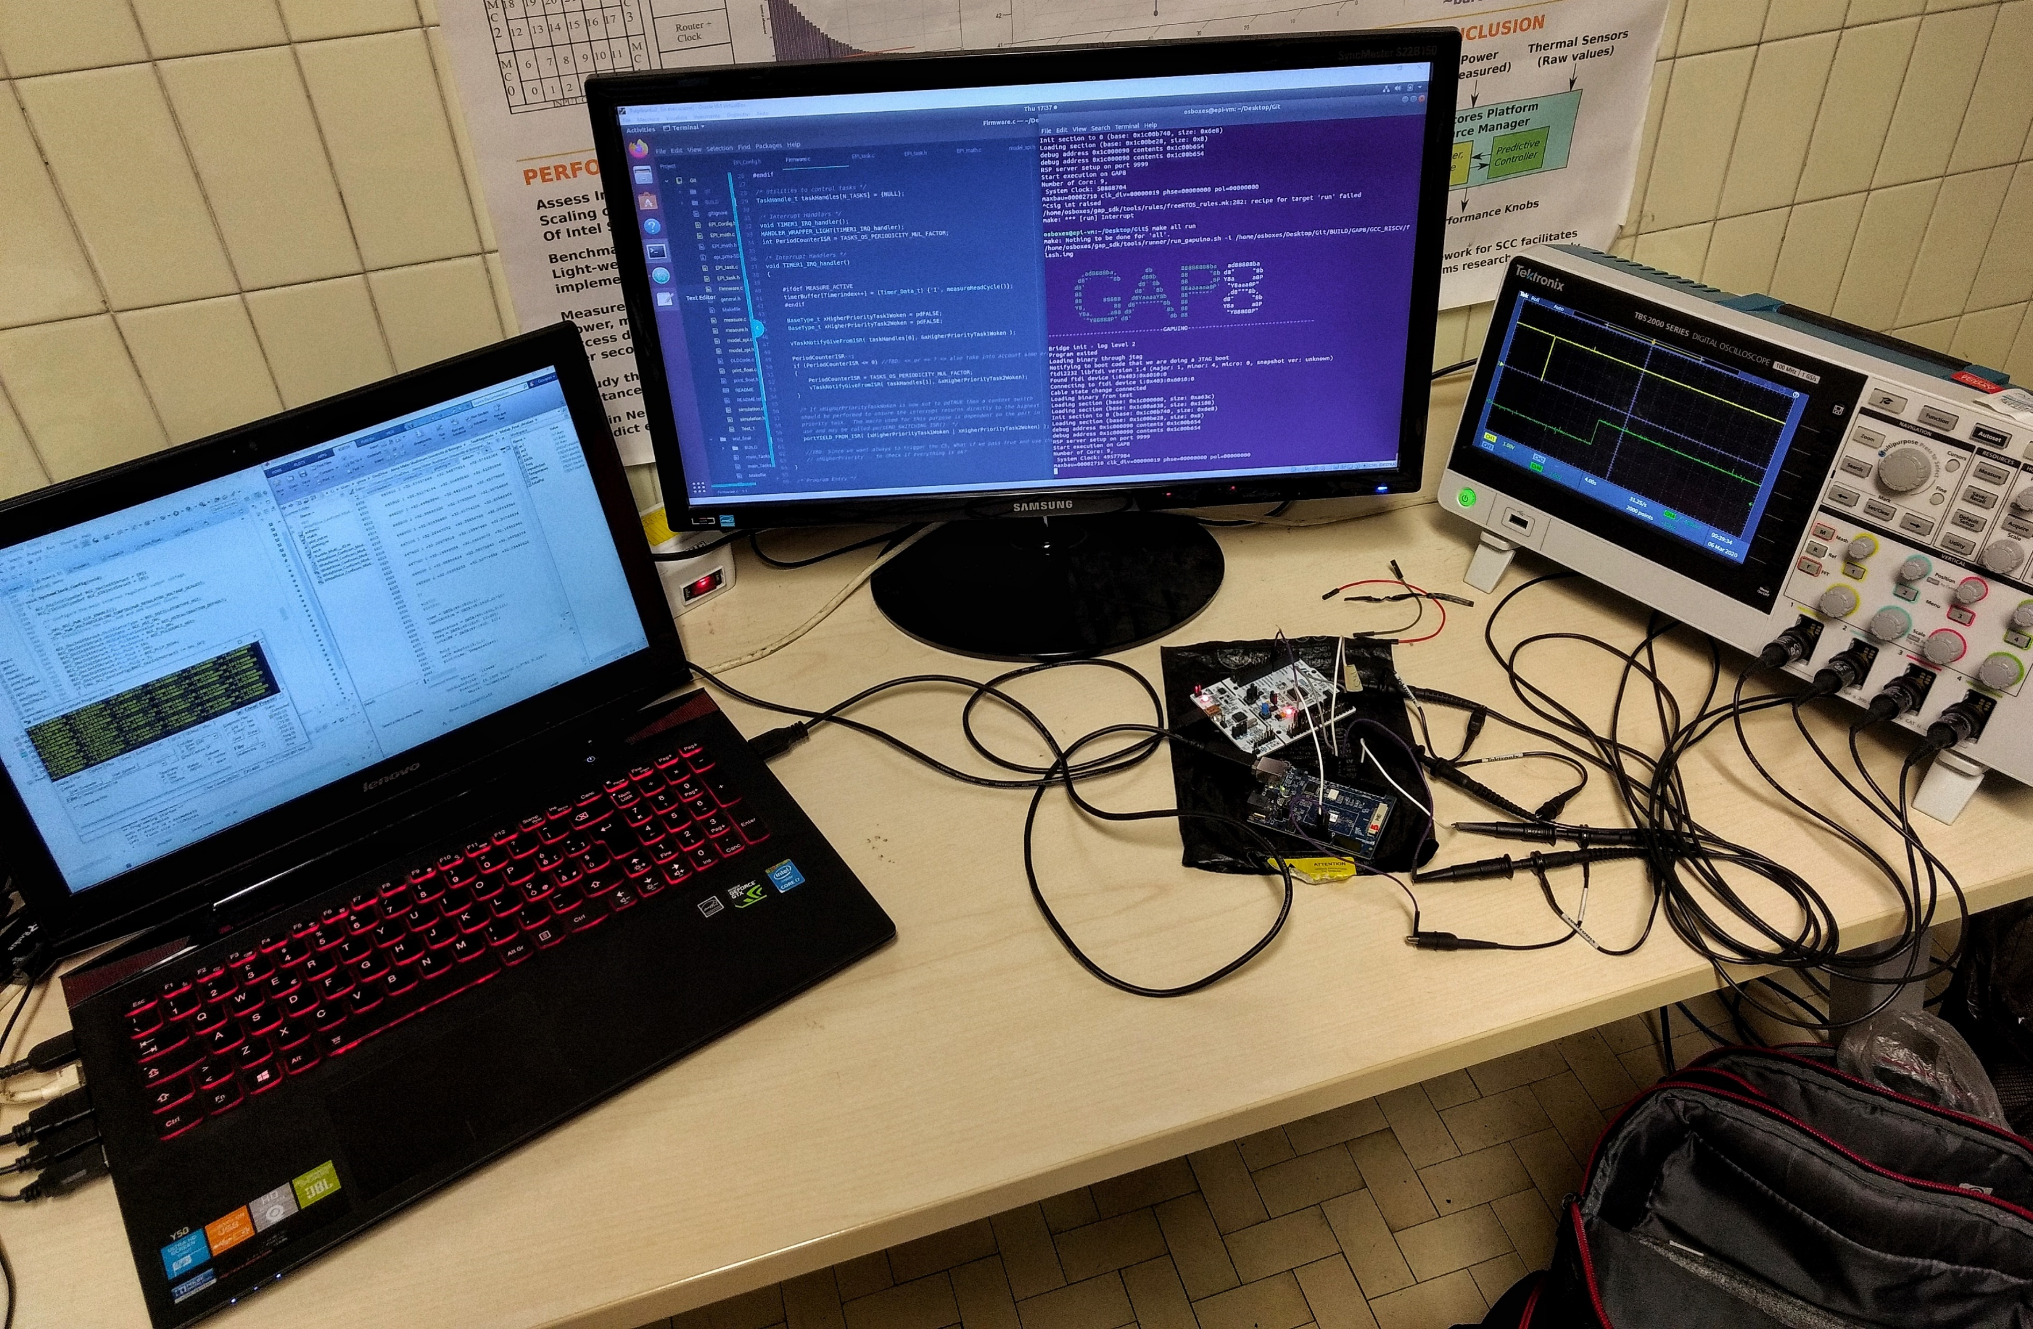
Grazie dell’attenzione

Slide 23
Outline Introduction
01
INTRODUCTION – HPC & PCS
04
GAP8 PROTOTIPATION
Introduction to the HPC problem and PCS Requirements.
Implementation work of the PCS on GAP8 Hardware
02
CONTRIBUTION
05
CO-SIMULATION SETUP
Contribution and obtained results of this Thesis.
Design and Set-up of the Hardware-in-the-Loop test
03
PCS ARCHITECTURE
06
EXPERIMENTAL RESULTS
Design and implementation choices.
Test methodology. Results and improvements.

Slide 24
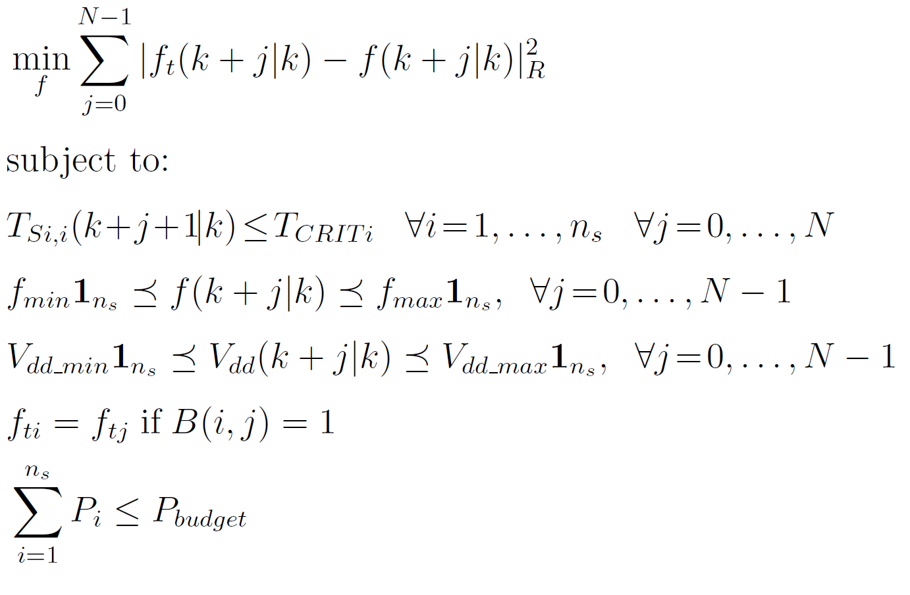
OPTIMIZATION PROBLEM
Where:
f are the decision variables (i.e. Frequencies to be assigned)
k denotes the discrete time variable
N is the number of steps assumed are the horizon
T_{crit} is the critical temperature
T_{si,i} are the thermal states of the chip (i.e. the temperature in the silicon of each component)
N_{s} is the number of elements/cores
B(i, k) is a n_{s} x n_{s} symmetric matrix to describe binding constraints
The Optimization Problem
Is a Convex Quadratic Problem that can be solved by numerical iterative optimization algorithm

Slide 25
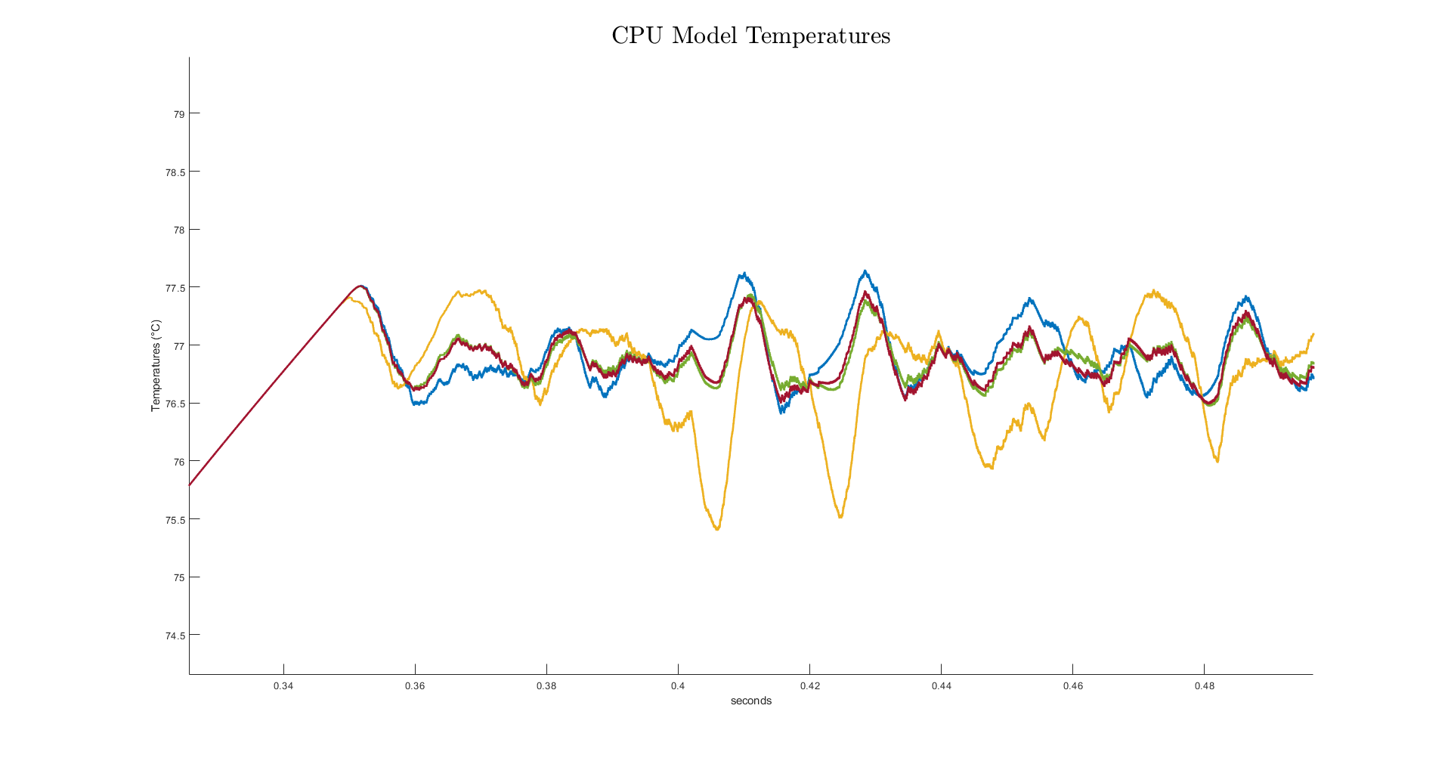
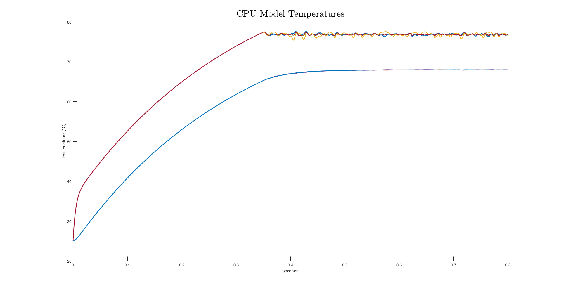
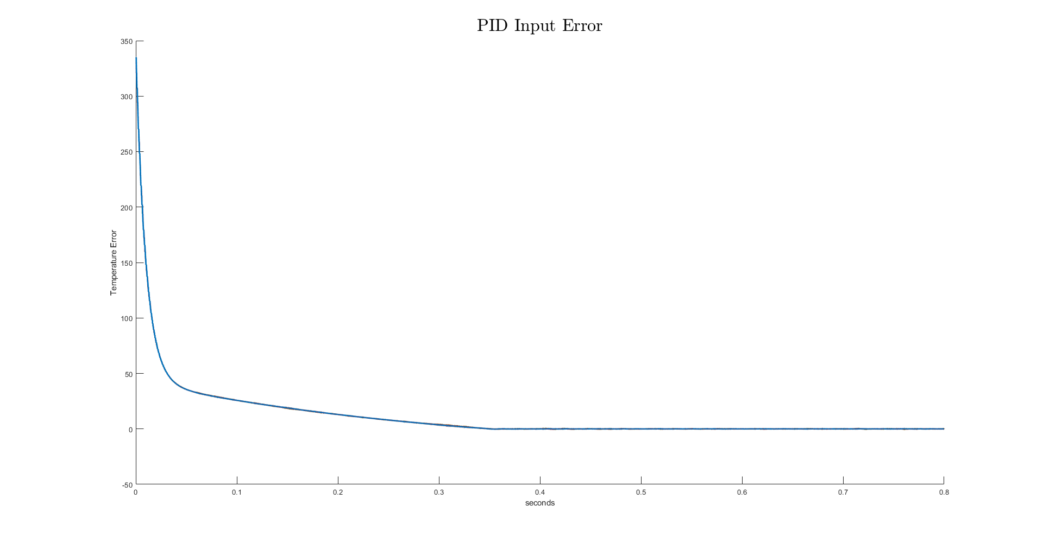
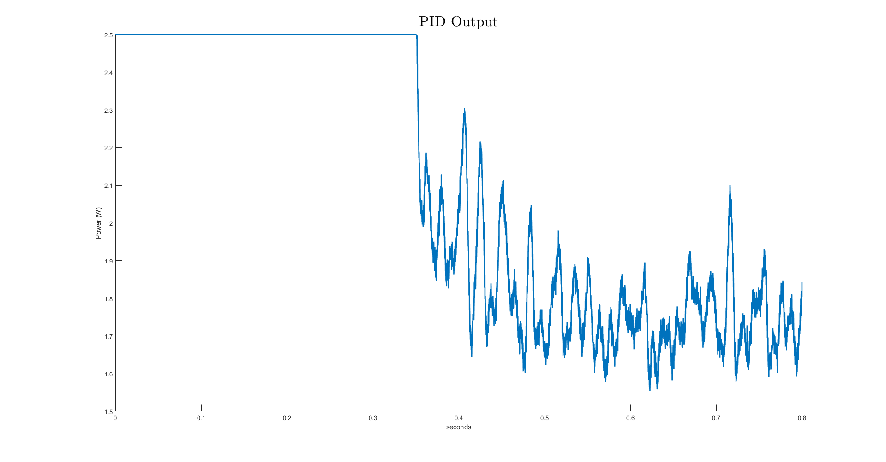
MATLAB/SIMULINK TEST

Slide 26


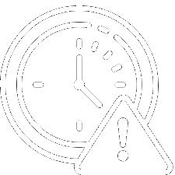


Setting Up the HiL Test Bugs and Journey
Timer ISR Priority Bug
uDMA Bugs
FreeRTOS Priority Config.
A bug in SDK v2.7 wouldn’t allow to call FreeRTOS APIs inside ISR
uDMA was afflicted by multiple bugs that made SPI communication not consistent, application crashes, GPIOs bugs, …
The maximum number of FreeRTOS priority was 2
SPI API Utilization
3+ SPI Config. Bugs
SPI Clock – PLL Bug
Lack of Documentation and examples along with confusing names made it difficult to use SPI APIS
SDK v3.2 had multiple SPI configuration bugs and Configuration APIs missing
GAP8v1 has a bug in the configuration of the SPI clock related to the PLL

Slide 27
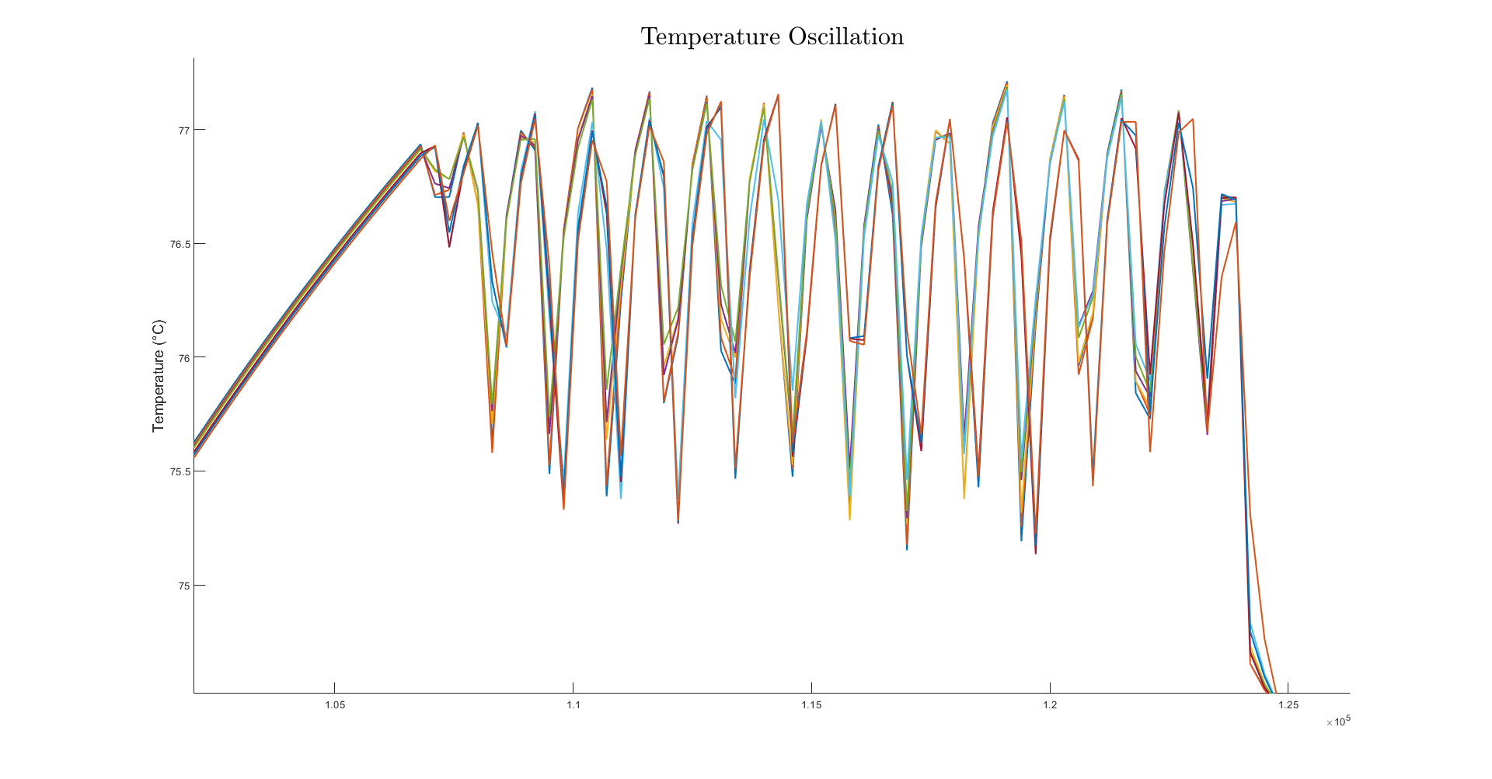
HIL RESULTS
HPC Workload
Simulation:
Action 1: Normal
Action 2: Thermal Constraint
Action 3: Power Capping
Action 4: Thermal Constraint
Action 5-6: Workload Relaxation
Action 7-8: Thermal Constraint
Action 9 Power Capping

